Slide 1
DEVOPS
CI/CD

Slide 2
Introduction to CI/CD
Continuous Integration (CI) and Continuous Deployment/Delivery (CD) are practices used in modern software development to improve code quality, reduce integration issues, and accelerate the delivery of software.

Slide 3
Benefits of CI/CD
Faster Delivery of Features:
Automating the process of integrating and deploying code allows for faster and more frequent releases.
Improved Code Quality:
Automated testing and integration help catch bugs and issues early, leading to higher-quality code.
Reduced Integration Issues:
Continuous integration ensures that code changes are frequently merged and tested, reducing the likelihood of integration problems.
Enhanced Collaboration:
CI/CD practices promote collaboration among team members by providing a unified and automated workflow.
Early Detection of Bugs:
Automated tests run as part of the CI/CD pipeline catch bugs early in the development cycle, making them easier and cheaper to fix.
Consistent Deployment Process:
Automated deployments ensure that the deployment process is consistent and repeatable, reducing human error.

Slide 4
Key Concepts
Key Concepts
Build
Test
Deploy

Slide 5
Build
Definition:
The build process involves compiling the source code, resolving dependencies, and packaging the software into a deployable format (e.g., executable, container).
Automation:
Tools like Maven, Gradle, or npm are often used to automate the build process.
Example:
In a Java project, the build process might involve compiling .java files into .class files and then packaging them into a .jar or .war file.

Slide 6
Test
Automated tests are run to validate the functionality, performance, and security of the code.
Types of Tests:
Unit Tests: Test individual components or functions.
Integration Tests: Test the interaction between different components.
End-to-End Tests: Test the application from the user's perspective.
Tools:
Common testing frameworks include JUnit, TestNG, Selenium, and Jest.
Example:
Running JUnit tests as part of the build process to ensure that all methods in a Java class work as expected.

Slide 7
Deploy
Definition:
Deployment is the process of releasing the built and tested code to a production or staging environment.
Automation:
Deployment pipelines automate the steps required to deploy the application, including environment setup, database migrations, and service restarts.
Tools:
Popular deployment tools and platforms include Jenkins, GitLab CI, CircleCI, and AWS CodePipeline.
Example:
Using Jenkins to automate the deployment of a web application to a production server after passing all tests.

Slide 8
CI/CD Pipeline steps
Code Commit: Developers commit code changes to a version control system (e.g., Git).
Build: The CI server automatically triggers a build process.
Test: Automated tests are run on the built code.
Deploy: If tests pass, the code is automatically deployed to a staging or production environment.
Feedback: Results of the build, test, and deploy processes are reported back to the development team for further action.

Slide 9
Tools for CI/CD
Jenkins:
An open-source automation server used for building, testing, and deploying code.
GitLab CI:
A built-in CI/CD tool in GitLab that allows for seamless integration with GitLab repositories.
CircleCI:
A cloud-based CI/CD tool that automates the build, test, and deploy processes.
Travis CI:
A CI service used to build and test projects hosted on GitHub.
Azure DevOps:
A suite of development tools provided by Microsoft, which includes CI/CD capabilities.

Slide 10
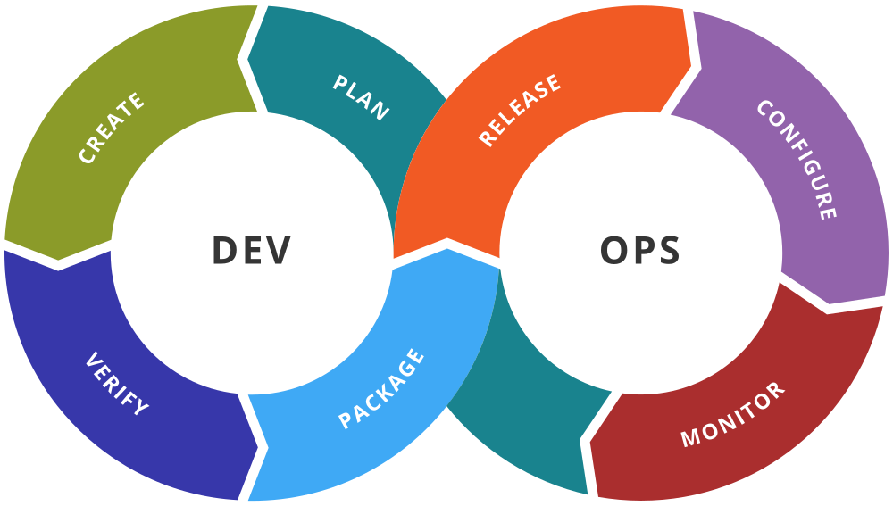
DevOps
DevOps is a set of practices that combines software development (Dev) and IT operations (Ops) with the aim of shortening the software development lifecycle and providing continuous delivery with high software quality.

Slide 11
Key Concepts and Benefits:
Collaboration and Communication: Encourages collaboration between development and operations teams to improve productivity and reduce silos.
Automation: Emphasizes the automation of repetitive tasks, such as testing, integration, and deployment, to increase efficiency and reduce errors.
CI/CD: Ensures code changes are automatically built, tested, and deployed to production, allowing for faster and more reliable releases.
Monitoring and Logging: Continuously monitors the performance and logs of applications to identify and resolve issues promptly.
Infrastructure as Code (IaC): Manages and provisions computing infrastructure through machine-readable scripts, enhancing consistency and scalability.

Slide 12
Tools
Jenkins, Travis CI, CircleCI: CI/CD tools for automating the build and deployment processes.
Docker, Kubernetes: Containerization and orchestration tools for managing application deployments.
Ansible, Terraform: IaC tools for provisioning and managing infrastructure.
Prometheus, Grafana: Monitoring and alerting tools.

Slide 13
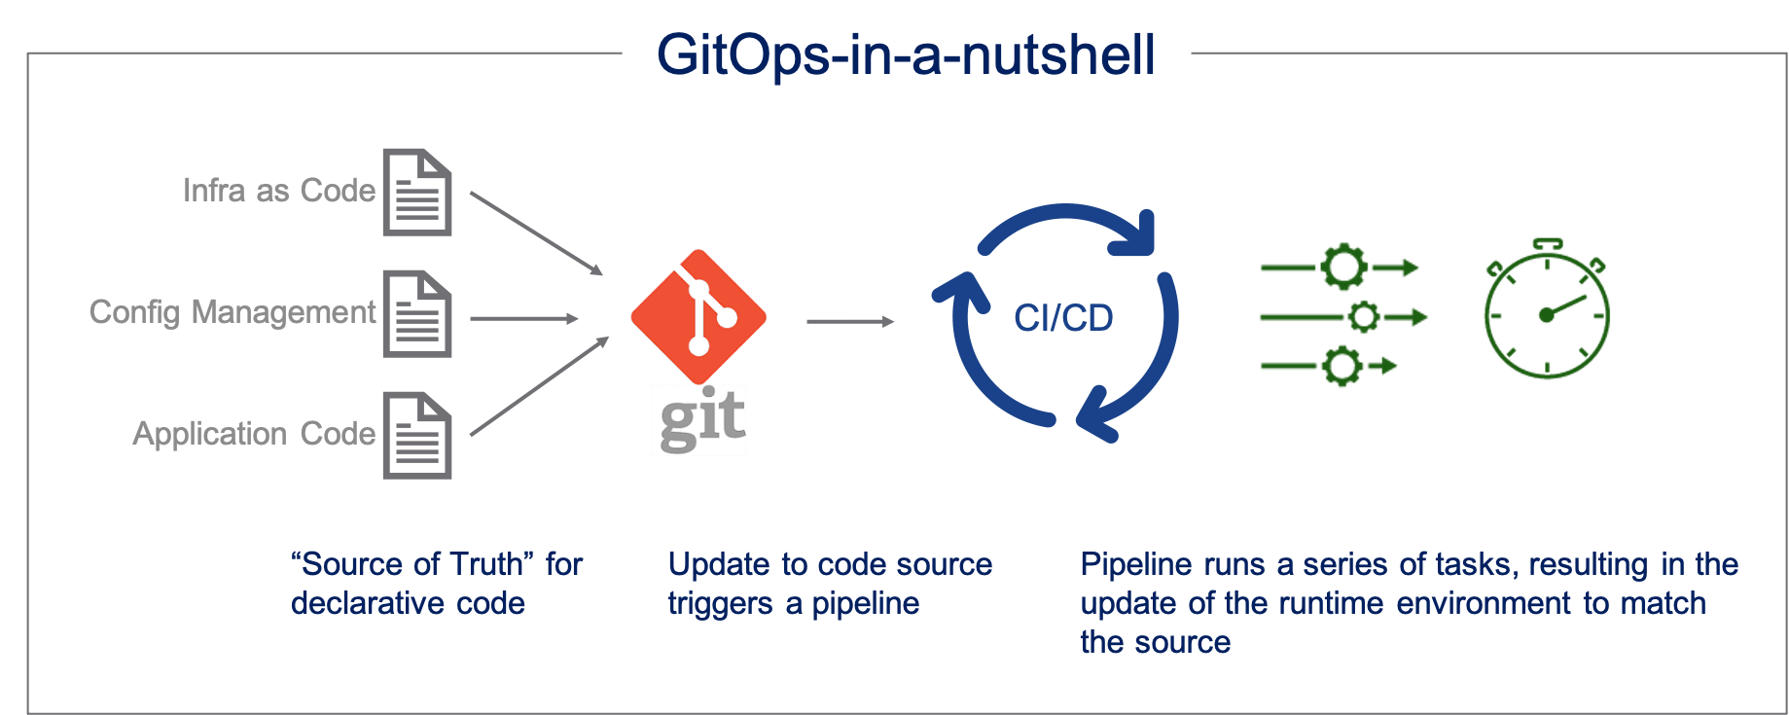
GitOps
GitOps is a subset of DevOps practices that uses Git as the single source of truth for declarative infrastructure and application code, automating the deployment and management of applications.

Slide 14
Key Concepts and Benefits
Declarative Configuration: Defines the desired state of the infrastructure and applications in Git, making it easier to manage and track changes.
Version Control: Uses Git to version control configurations and code, providing a clear audit trail of changes.
Automated Deployments: Deploys changes automatically when updates are pushed to the Git repository, ensuring consistency between the Git state and the deployed state.
Rollback and Recovery: Facilitates easy rollback to previous states in case of issues, improving reliability and stability.
Enhanced Security: Ensures that all changes go through the Git repository, making unauthorized changes less likely.

Slide 15
Tools
Flux, Argo CD:
GitOps tools for automating the deployment of applications using Git as the source of truth.
Kustomize, Helm:
Tools for managing Kubernetes configurations declaratively.
GitHub, GitLab:
Version control systems for managing code and configuration.

Slide 16
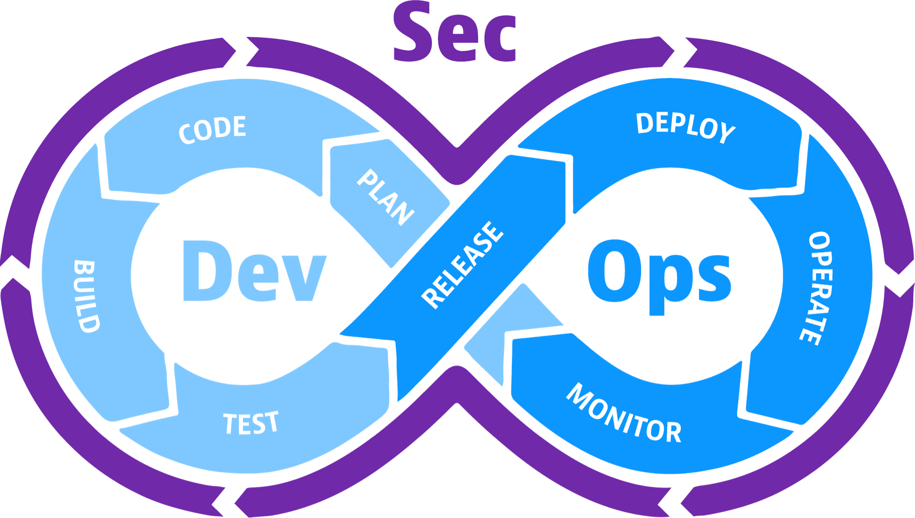
DevSecOps
DevSecOps integrates security practices within the DevOps process, ensuring that security is considered at every stage of the software development lifecycle.

Slide 17
Key Concepts and Benefits
Shift Left Security: Incorporates security practices early in the development process to identify and fix vulnerabilities sooner.
Automation: Automates security testing and compliance checks as part of the CI/CD pipeline to reduce manual efforts and ensure consistent security standards.
Collaboration: Promotes collaboration between development, security, and operations teams to address security concerns proactively.
Continuous Monitoring: Continuously monitors applications and infrastructure for security threats and vulnerabilities.
Compliance and Governance: Ensures that applications comply with regulatory requirements and organizational policies.

Slide 18
Tools
SonarQube, Checkmarx: Static code analysis tools for identifying security vulnerabilities in the code.
Aqua Security, Twistlock: Container security tools for scanning and protecting containerized applications.
OWASP ZAP, Burp Suite: Tools for performing dynamic application security testing (DAST).
Vault, CyberArk: Secrets management tools for securely storing and managing credentials and sensitive information.

Slide 19
Comparison
DevOps focuses on improving collaboration between development and operations, emphasizing automation, continuous integration, and delivery.
GitOps extends DevOps by using Git as the single source of truth for declarative infrastructure and application deployment, enabling automated and consistent deployments.
DevSecOps integrates security into the DevOps process, ensuring that security is an integral part of the development lifecycle.

Slide 20
Introduction to Jenkins
Jenkins is an open-source automation server used to automate various aspects of the software development process, including building, testing, and deploying applications.
It is one of the most popular tools in the DevOps toolkit and is widely used for continuous integration and continuous delivery (CI/CD).

Slide 21
Key Features
Extensible: Jenkins has a rich ecosystem of plugins that allow it to integrate with many other tools and platforms, making it highly customizable.
Distributed Builds: Jenkins can distribute builds and tests across multiple machines to improve performance and reliability.
Easy Configuration: Configuration can be done through a web-based interface, making it accessible to users without a deep understanding of the command line.
Pipeline as Code: Jenkins supports writing build pipelines as code using the Groovy-based Domain Specific Language (DSL), allowing version control and more complex workflows.
Community Support: As an open-source tool, Jenkins has a large community that contributes plugins, documentation, and support.

Slide 22
Key Concepts
Key Concepts
Jobs & Builds
Pipelines
Nodes & Executors
Plugin

Slide 23
Jobs:
In Jenkins, a job (or project) is a task or set of tasks that Jenkins executes.
Jobs can be configured to perform various tasks such as building code, running tests, or deploying applications.
Builds:
Each execution of a job is called a build.
Builds can be triggered manually, scheduled, or triggered automatically by events such as code commits.
Pipeline:
A pipeline is a suite of plugins that supports implementing and integrating continuous delivery pipelines. It defines the entire build lifecycle of an application.
Declarative Pipeline: A simpler and more structured way to define pipelines using a specific syntax.
Scripted Pipeline: A more flexible way to define pipelines using a general-purpose Groovy script.

Slide 24
Nodes:
Machines where Jenkins runs jobs. The main Jenkins server is called the "master," and additional machines are called "agents" or "slaves."
Executors:
The number of concurrent jobs a node can run.
Plugins:
Jenkins' functionality can be extended through plugins, which integrate with other tools and add new features.
Examples include Git, Docker, Maven, and Slack integrations.

Slide 25
Install Jenkins
Download Jenkins: Jenkins can be downloaded from official website
Install Jenkins: Follow the installation instructions for your operating system. Jenkins can be installed as a standalone application or deployed in a servlet container such as Apache Tomcat.
Start Jenkins: Once installed, start Jenkins and access it through a web browser at http://localhost:8080 by default.
Initial Setup: Complete the initial setup by installing recommended plugins and creating an admin user.

Slide 26
Activity 1
Let’s Create 1 AWS Instance
Install Jenkins
Install JDK
Start Jenkins Service
Check status
Download Jenkins.war file
Execute below command
Java –jar jenkins.war
It will start jenkins service on 8080 port
Localhost:8080
Install suggested plugins
Start working with jenkins

Slide 27
Activity 2
Create Free Style Project
In configuration:
Discard old build: select
If git needed you can select otherwise keep none
Select any Build Triggers and Build Environment as per your task requirements
Now, configure your build by clicking on Add build step and selecting Execute Shell
Add the list of shell commands that you want the Build to execute automatically
Java -version
Add additional Build steps by clicking Add build step > Execute Shell. These build steps can be different, as they are separate jobs that Jenkins executes sequentially.
Echo “thank you for using Jenkins”
Save
Click on Build now
Check output in console

Slide 28
Activity: Build Maven App in Jenkins
Create free style project
In git add maven project repo link
Go to the Build tab and select Invoke top-level Maven targets
Add clean
One more build with target: package
Build now check console

Slide 29
Maven plugin Integration
Configuring plugin by clicking on manage plugins
Click on the AVAILABLE button to access the available plugins
search for Maven Integration u
After the plugins are installed successfully, select Restart Jenkins
Now you can see maven project creation option on Jenkins Dashboard

Slide 30
Configure Maven Version
Manage jenkins
Global tools configuration
Maven → Add maven
Give the name → install automatically
Click save

Slide 31
Create Maven Project
Select Maven project in JOB
Add description
Add git repo link with branch name
In configure add goals and options: clean package
Scroll and save
Build now
Check console

Slide 32
Working with Jenkins Pipeline
Click on newItem
Select pipeline
In pipeline select hello pipeline script
Save
Build now
Check console

Slide 33
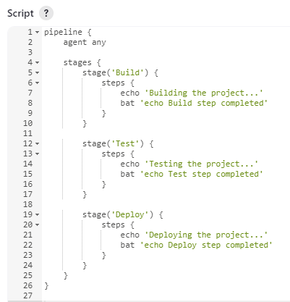
Pipeline with stages
newItem → pipeline
Select hello script
Edit with other stages like build, test, deploy
Save
Build now
Check console

Slide 34
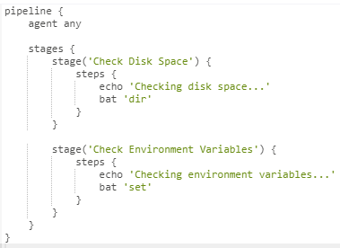
Pipeline Activity 1
Simple Shell Commands Pipeline

Slide 35
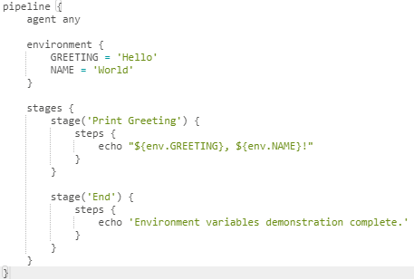
Pipeline Activity 2 Using Environment Variables

Slide 36
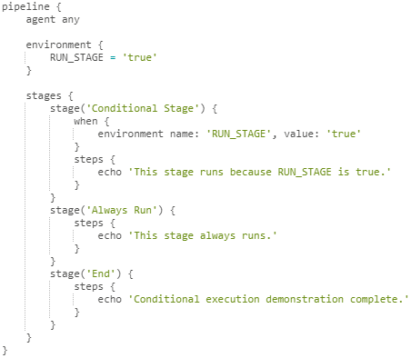
Pipeline Activity 3: Conditions

Slide 37
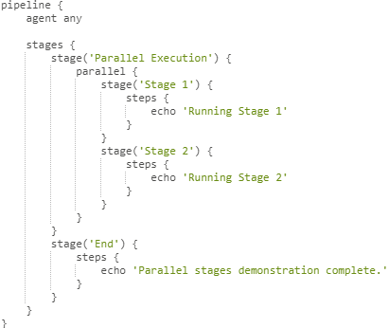
Activity 4:Parallel Execution

Slide 38
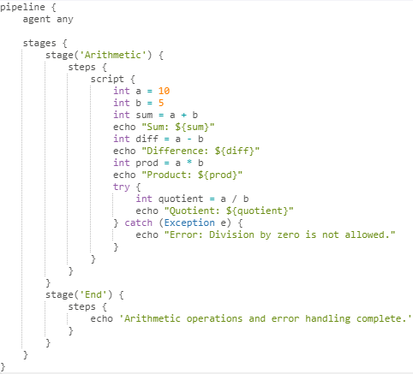
Activity 5:Arithmetic & Error Handling

Slide 39
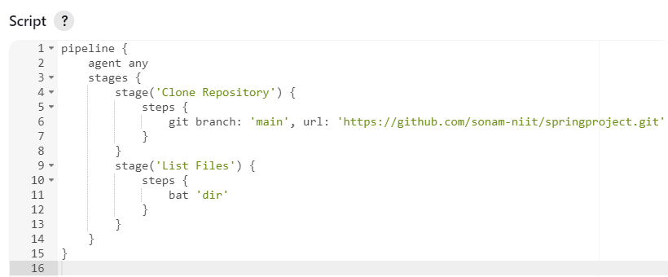
Pipeline For Git Clone Repo

Slide 40
Poll SCM
To set up Jenkins to automatically trigger a build whenever there are changes in your source code repository.
Polling Schedule:
In the Schedule field, you need to enter a cron-like schedule to tell Jenkins how often to check for changes.
H/5 * * * * - Poll every 5 minutes.
H 9 * * 1-5 - Poll at 9 AM every weekday.
H 2,14 * * * - Poll at 2 AM and 2 PM every
H: A Jenkins-specific feature that spreads load evenly by choosing a random value within the specified range.
/5: Every 5 minutes.
* * * * : Specifies the time format: minute hour day month dayOfWeek.

Slide 41
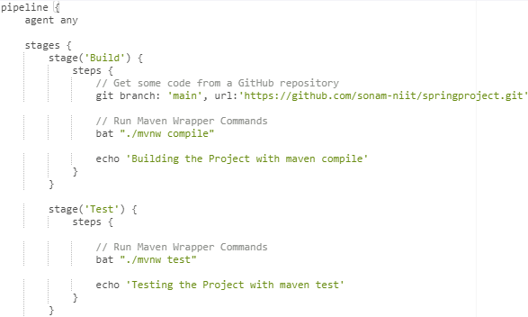
Project Pipeline

Slide 42
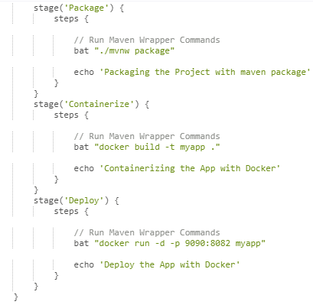

Slide 43
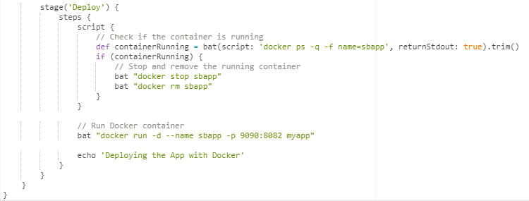
Improving Deploy Stage

